Slide 1
Garbage Collector Robot for Water Surface

Slide 2
Aim/Objectives
The primary aim of Project is reduce pollution in water surface. To analyze the problem of garbage disposal at a sea or any other suitable location. To design and develop a system for solving the problem. To test and maintain the implemented system.

Slide 3
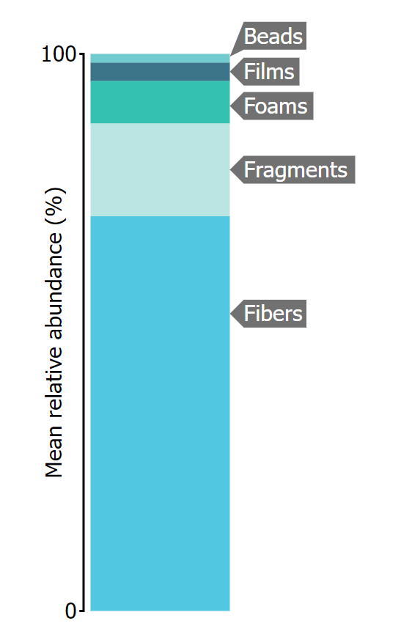
What is general water pollutants ?
Beads and Pellets made up 1.6% of sampled microplastics
Films made up 3.3% of sampled microplastics
Foams made up 7.6% of sampled microplastics
Fragments made up 16.7% of sampled microplastics
Fibers and Lines made up 70.9% of sampled microplastics

Slide 4
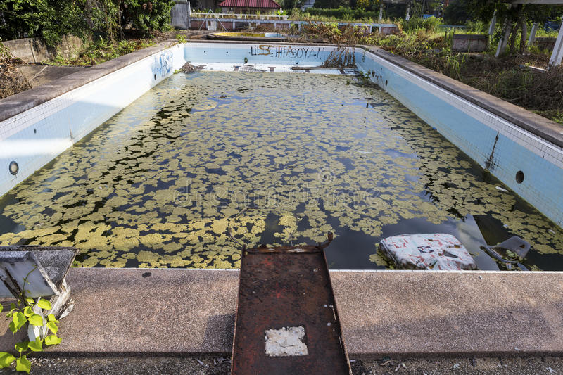
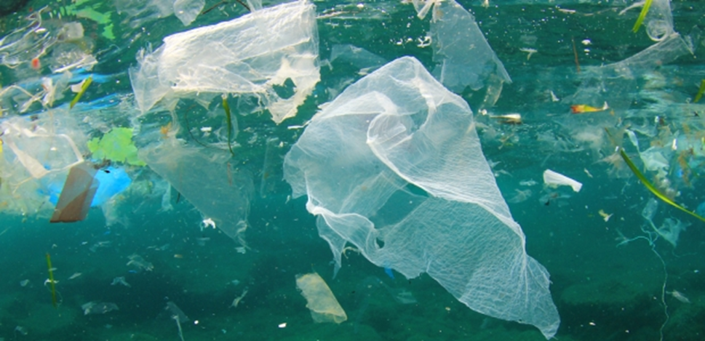
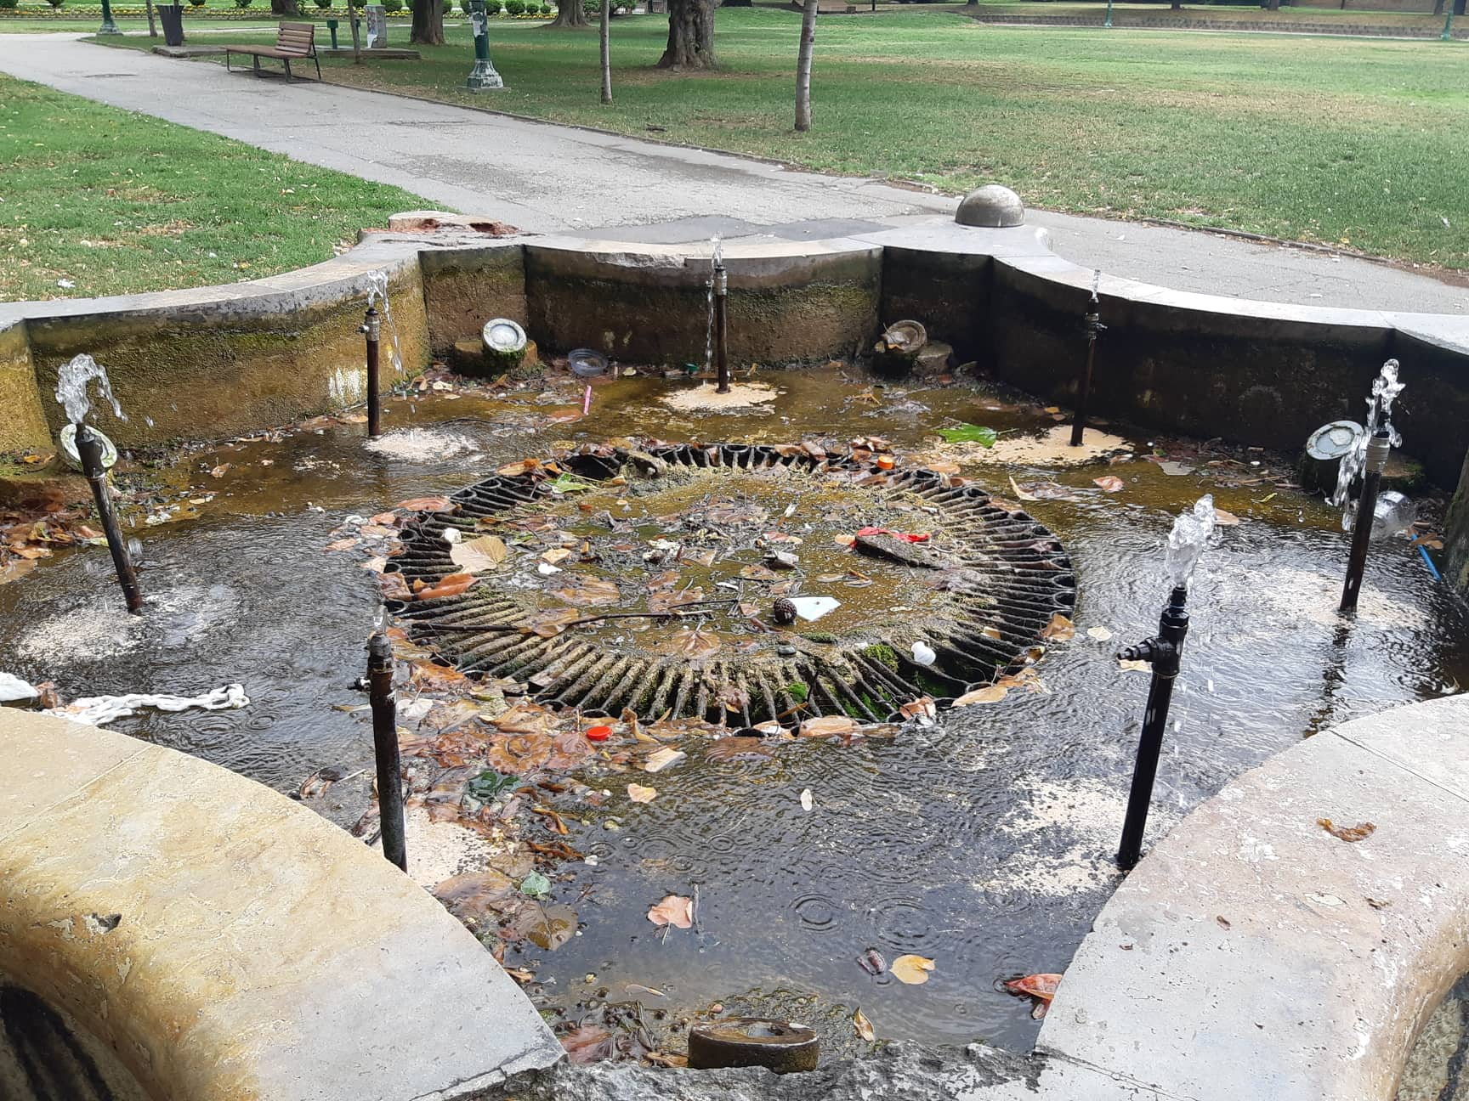
What water surfaces are Robot for ?
Public pools pollution
Small Lakes
Ponds
Canals (water canals pollution)

Slide 5
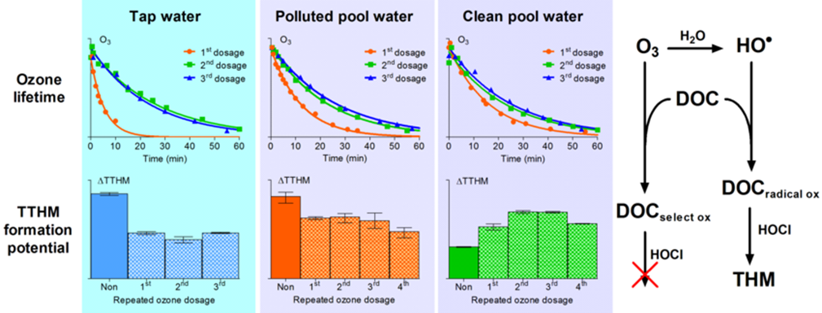
Pools Pollution
Public swimming pools pollution
Artificial lakes pollution at the parks
Fountain pools pollution
Private pools (at the home)

Slide 6
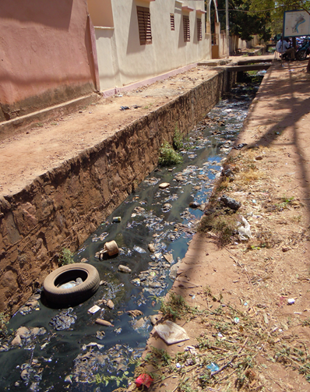
Canals Pollution
Drinking water canals pollution
Irrigation water canals pollution
Wastewater canals pollution

Slide 7
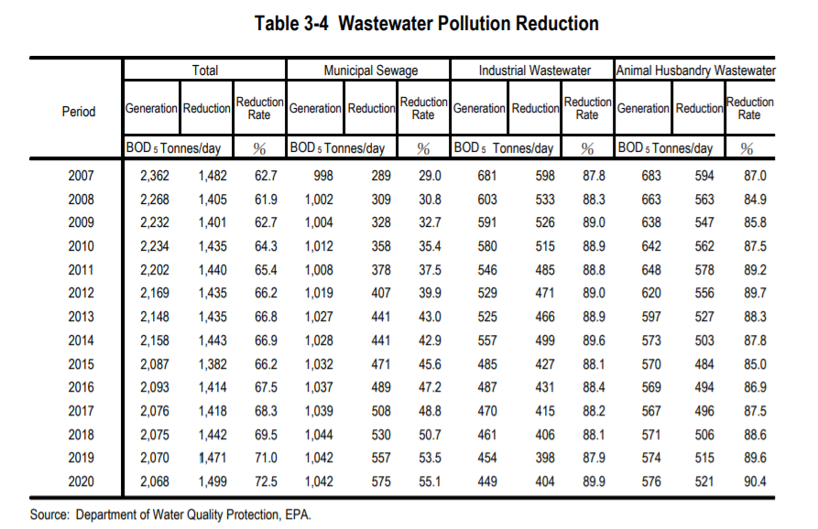

Slide 8
Lake Pollution
Small Lakes
Ponds
Small coastal or estuarine waters

Slide 9
Hardware of Robot
Arduino Uno
DC Gear Motor
L298N Motor Driver
HC-05 Bluetooth Model

Slide 10
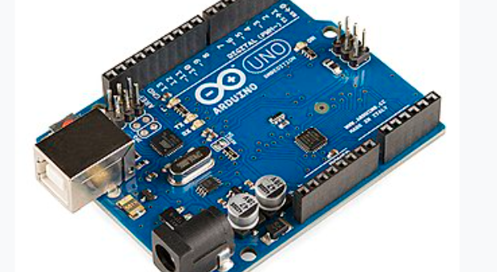
Analyze Hardware Component of Arduino Uno

Slide 11
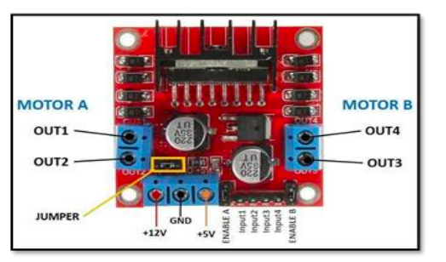
L298N Motor Driver
The L298N Motor Driver is a dual H-Bridge motor driver which allows speed and direction control of two DC Motors at the same time. The Module can drive DC Motors that have voltages between 5 and 35V, with a peak current up to 2A

Slide 12
Software of Robot
Algorithm
Arduino IDE

Slide 13
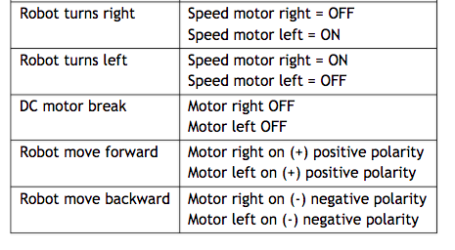
Basic Operations and Conditions for the Water Surface Garbage Collector Robot

Slide 14
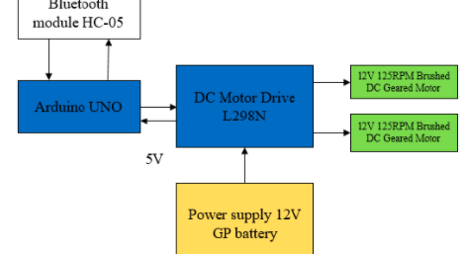
Block Diagram of the system

Slide 15
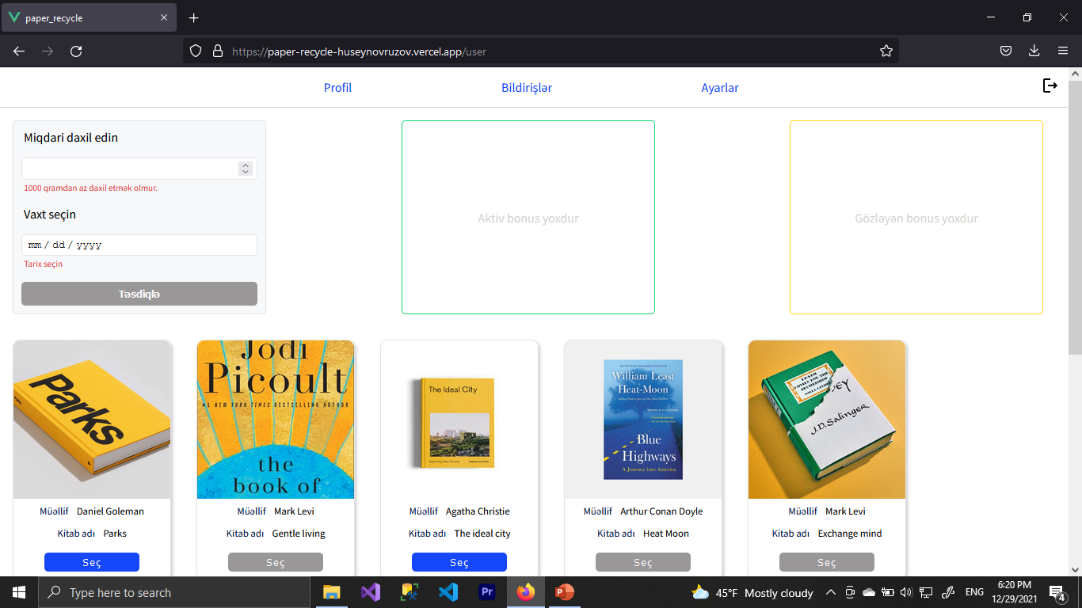
What we offer to customers?

Slide 16
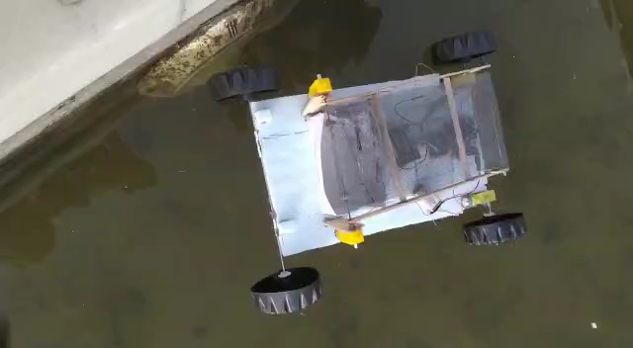
How it works?

Slide 17
Thanks for attention!!

